Slide 1


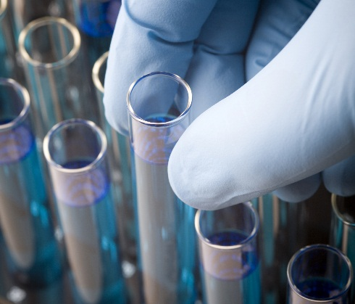
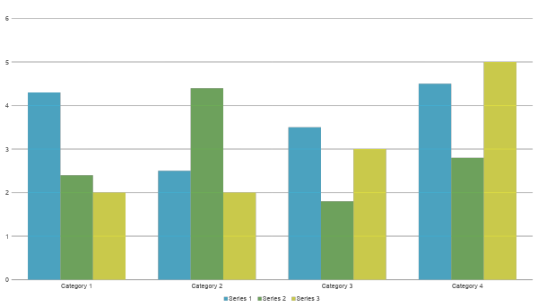
Science Project Title
Scienteer Project #
Problem / Question
Materials
Photos
Results
Enter your question here (statement of the problem)
Quantity (detailed list) | Materials (be specific)
Amount | Item
Amount | Item
Amount | Item
Amount | Item
Amount | Item
Amount | Item
Amount | Item
Include results based on your experiments
Result 2
Result 3
Hypothesis
Write hypothesis before you begin the experiment
This should be your best educated guess based on your research
If you are doing an engineering project, this section should be your Engineering Goal
Procedure
Conclusion
Write out all steps in your procedure in a numbered list
This should be step 2
Brief summary of what you discovered based on results
Indicate and explain whether or not the data supports your hypothesis
Variables
Charts
Controlled variables
Independent variable
Dependent variable
These are kept the same throughout your experiments
The one variable you purposely change and test
The measure of change observed because of independent variable
Decide how you will measure the change
Works Cited
Include print and electronic sources in alphabetical order
Background Research
Data / Observations
Graphs
Add a brief overview of the background research for your project.
Observation 1
Observation 2
Observation 3
Photo Credit
All photos, images, and graphics were done by the researcher or parent unless otherwise stated.
IF YOU TOOK IMAGES FROM A WEBSITE, GIVE THEM CREDIT ON YOUR BOARD.

Slide 2
Extra Slide
Project Board Rules
A virtual project board must be uploaded prior to the deadline set for the fair.
All ISEF Display and Safety Rules must be followed as well as any additional rules below.
Students are allowed three 48” x 36” slides.
The first slide should be modeled after a science fair board (see example on previous slide) and include all key information including Problem/Question, Hypothesis or Engineering Goal, Background Research, Materials, Procedure, Data, Results, and Conclusion.
The Scienteer Project # must be displayed under the Project Title on slide 1.
The example project board on the previous slide may be used by students. Formatting to change colors, text box sizes, move panels, etc. is acceptable. We want this to be your board. Just make sure to follow the rules as to what needs to be included.
The first slide must include a Photo Credit that gives credit for all photos, images, and graphics on the slides.
The second slide may include any supporting information for the project such as additional photos, charts, and graphs.
The third slide must include the Official SRC Approved Abstract from Scienteer as well as Form 1C (Regulated Research Institutional/ Industrial Setting Form) and Form 7 (Continuation/ Research Progression Projects Form) if required for your project.
Font on the boards must be 16pt or larger.
If slides contain photographs with people other than the researcher, the researcher must have photo releases available upon request.
The first two slides may NOT include an abstract. Only your official abstract from Scienteer should be included on slide 3.
The slides may NOT include any animations or videos. However, you can add a link to a video. It is up to the judges on whether or not they view the video.
The slides may NOT include any offensive or inappropriate images or photographs.
The slides may NOT include any reference to an institution or mentor that supported the work or to any patents pending other than what is displayed on Form 1C on slide 3.
The slides may NOT include any personal information such as email address, home address, phone number, or social media contacts.
You are allowed one extra slide for any additional data relevant to your project. Make sure to credit any sources of information that are not yours.

Slide 3
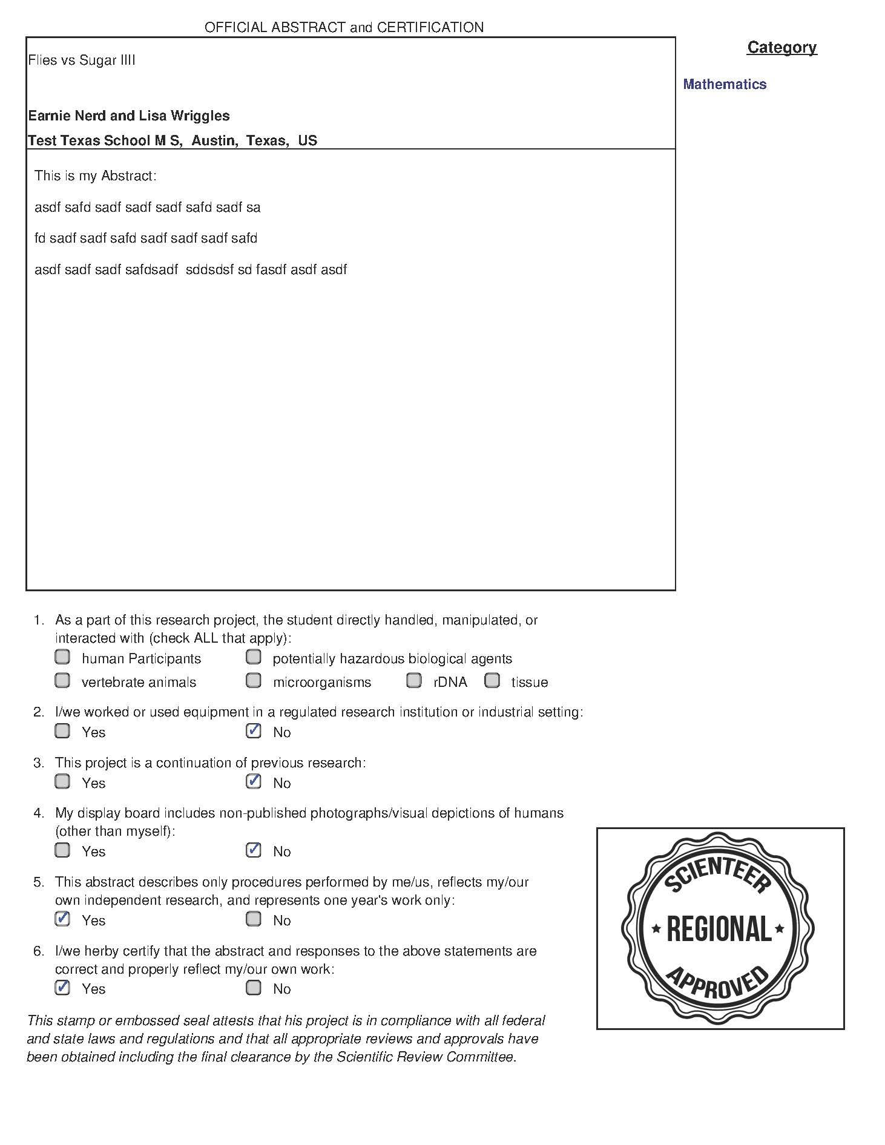
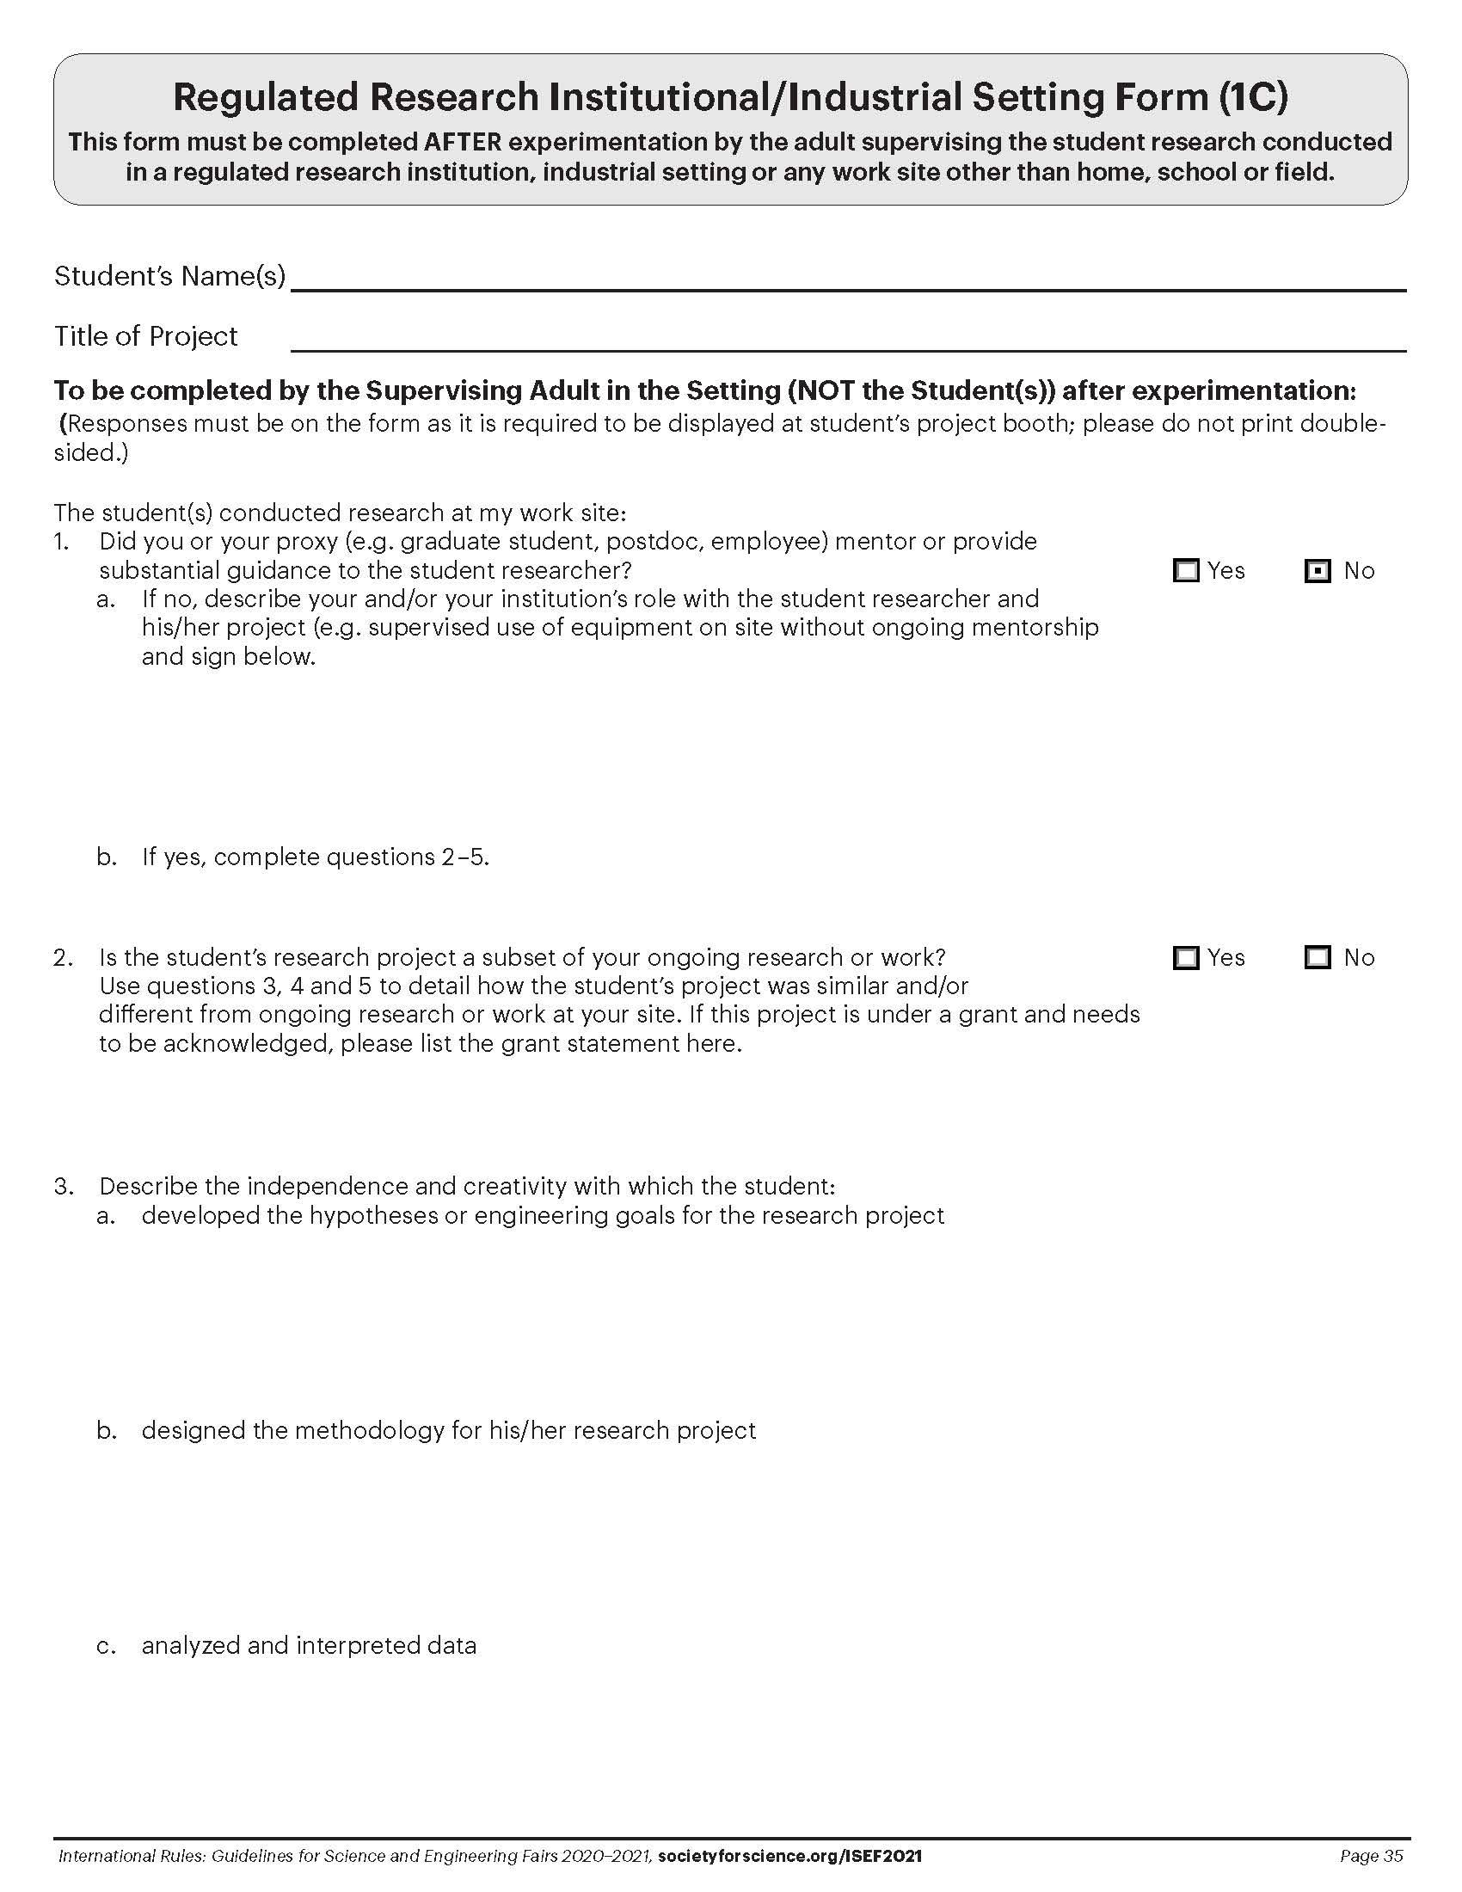
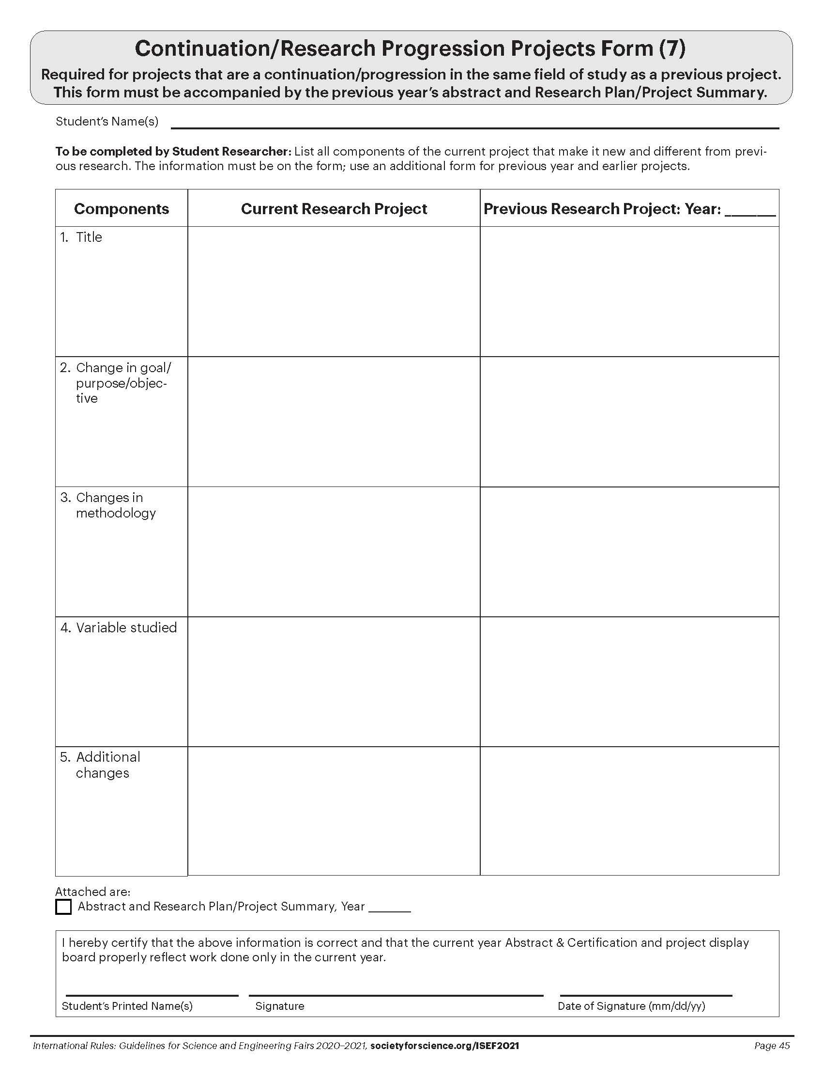
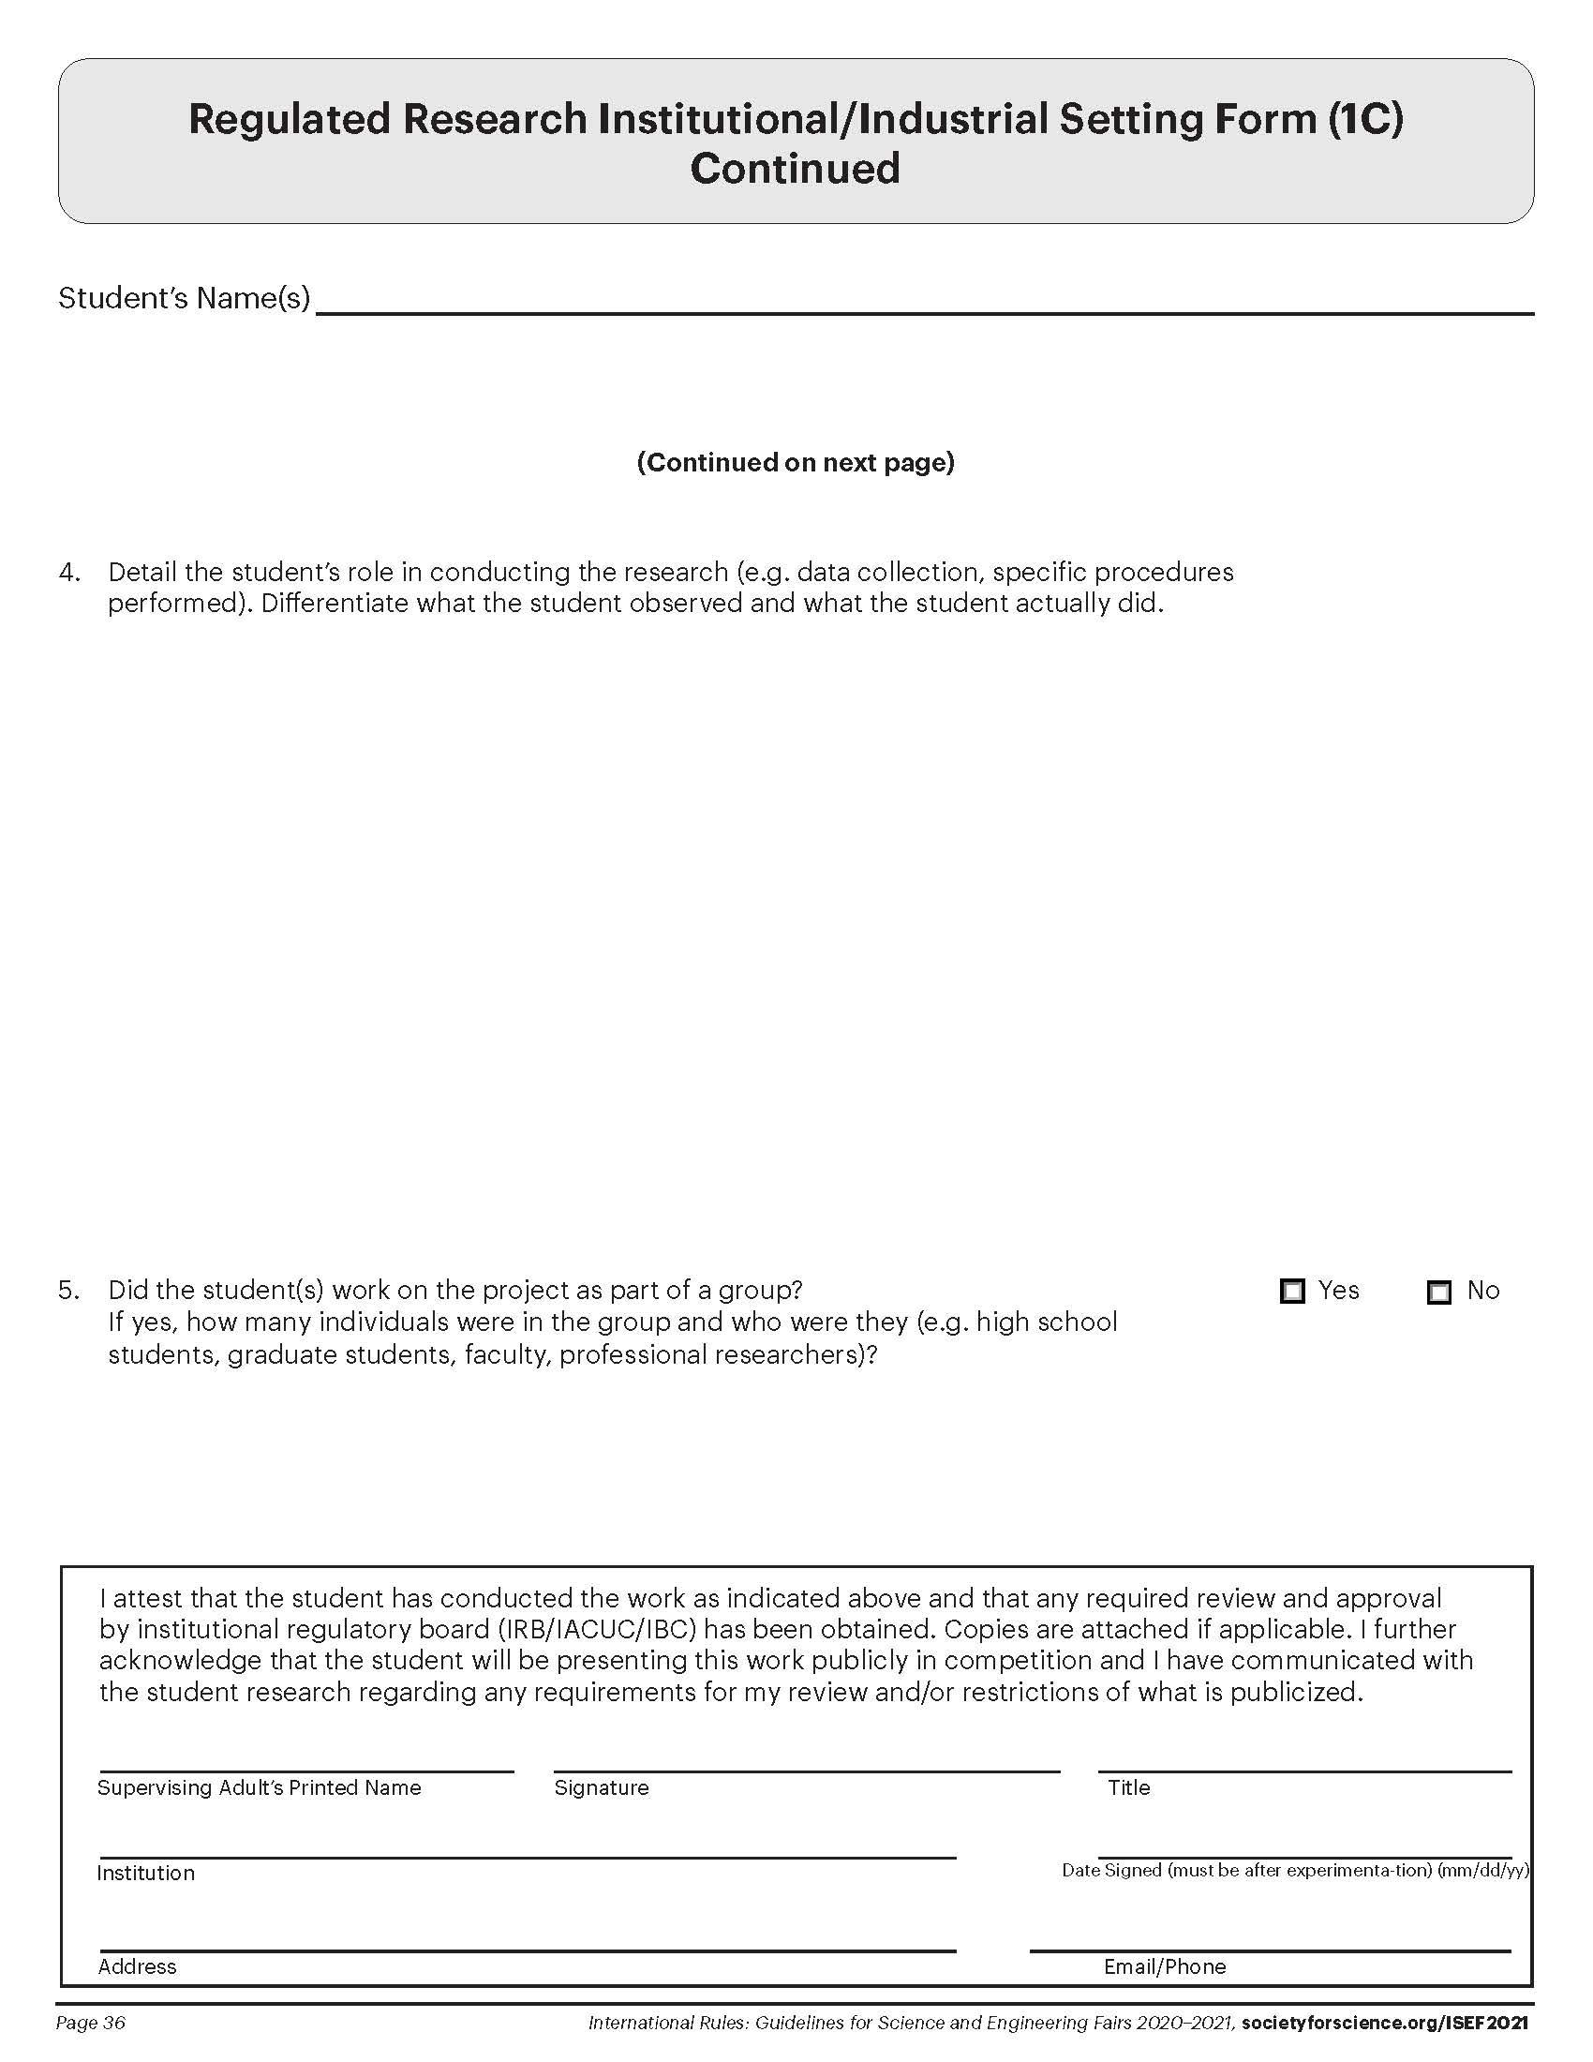
Project Forms
Instructions
Abstract
Form 1C (If Required)
Form 7 (If Required)
ALL Projects must display the Official SRC Approved Abstract from Scienteer as well as Form 1C (Regulated Research Institutional/ Industrial Setting Form) and/or Form 7 (Continuation/ Research Progression Projects Form) if required for your project.
These forms can be found on Scienteer on the Dashboard (left side of the screen).
The documents can be downloaded as pdfs.
In order to insert the documents on this slide, you will have to convert them to jpgs. You can use Adobe Acrobat, the Snip Tool, or any online conversion tool.
After inserting the documents on this slide, make sure that the forms are still clear enough to be read by the judges.
Example
Replace with Your Abstract from Scienteer
with the Official Seal
Example
Replace with Your Form 1C
from Scienteer (If Required)
Example
Replace with Your Form 7
from Scienteer (If Required)
Example
Replace with Your Form 1C
from Scienteer (If Required)

